Slide 1
Factory Pattern
By
Narendran, S S

Slide 2
Key Items
What is Factory Pattern?
Factory Pattern
Factory Method Pattern – Virtual Constructors, Template Methods
Abstract Factory Pattern
Factory Pattern with Registry, Reflection - OCP
Factory Pattern with Registry, without Reflection
Static Factory Pattern – Private Constructor
Factory Pattern with Singleton

Slide 3
What is Factory Pattern?
SELECT on DEMAND & CREATE on DEMAND (Selection & Creation)
Creates objects without exposing the instantiation logic to the client
Refers to the newly created object through a common interface
A factory is the location of a concrete class in the code at which objects are constructed. The intent in employing the pattern is to insulate the creation of objects from their usage and to create families of related objects without having to depend on their concrete classes. This allows for new derived types to be introduced with no change to the code that uses the base class.

Slide 4
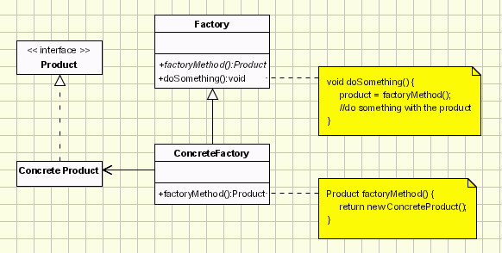
Factory Method Pattern - UML

Slide 5
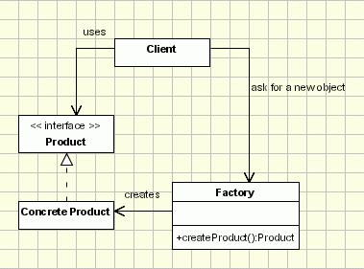
Factory Pattern - UML

Slide 6
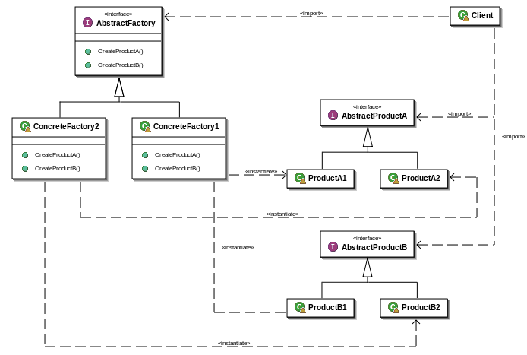
Abstract Factory - UML

Slide 7
Factory & other Patterns
Sometimes creational patterns are competitors: there are cases when either Prototype or Abstract Factory could be used profitably. At other times they are complementary: Abstract Factory might store a set of Prototypes from which to clone and return product objects, Builder can use one of the other patterns to implement which components get built. Abstract Factory, Builder, and Prototype can use Singleton in their implementation.
Abstract Factory, Builder, and Prototype define a factory object that’s responsible for knowing and creating the class of product objects, and make it a parameter of the system. Abstract Factory has the factory object producing objects of several classes. Builder has the factory object building a complex product incrementally using a correspondingly complex protocol. Prototype has the factory object (aka prototype) building a product by copying a prototype object.
Factory Method: creation through inheritance. Prototype: creation through delegation.
Factory Methods are usually called within Template Methods.
Prototype doesn’t require subclassing, but it does require an Initialize operation. Factory Method requires subclassing, but doesn’t require Initialize.

Slide 8
Factory & other Patterns
Abstract Factory classes are often implemented with Factory Methods, but they can also be implemented using Prototype.
Abstract Factory can be used as an alternative to Facade to hide platform-specific classes.
Builder focuses on constructing a complex object step by step. Abstract Factory emphasizes a family of product objects (either simple or complex). Builder returns the product as a final step, but as far as the Abstract Factory is concerned, the product gets returned immediately.
Often, designs start out using Factory Method (less complicated, more customizable, subclasses proliferate) and evolve toward Abstract Factory, Prototype, or Builder (more flexible, more complex) as the designer discovers where more flexibility is needed.

Slide 9
Pros & Cons
Pros
Provide an interface for creating families of related or dependent objects without specifying their concrete classes.
Encapsulates object Creation.
Cons
Introduces Indirection.

Slide 10
References
http://sourcemaking.com/design_patterns/abstract_factory

